Slide 1

MCA IV Semester Project Final Review Presentation
Student Name : P. Lalitha
Roll No : 23BFF00089
Project Title : Academic Performance Prediction Based on Multisource, Multi Feature Behavioral Data
Guide Name : Dr. N. Sudhakar Reddy , M.Tech, P.hD, FIE, FIETE, MISTE

Slide 2
CONTENTS
ABSTRACT
INTRODUCTION
PROBLEM STATEMENT
EXISTING SYSTEM
PROPOSED SYSTEM
SOFTWARE REQUIREMENTS
HARDWARE REQUIREMENTS
MODULES
UML DIAGRAMS
TESTING
SCREENSHOTS
CONCLUSION
REFERENCES

Slide 3
ABSTRACT
This project proposed , a model named Augmented Education (AugmentED). In our study,
First, an experiment is conducted based on a real-world campus dataset of college students (N = 156) that aggregates multisource behavioral data covering not only online and offline learning but also behaviors inside and outside of the classroom.
Specifically, to gain in-depth insight into the features leading to excellent or poor performance, metrics measuring the linear and nonlinear behavioral changes (e.g., regularity and stability) of campus lifestyles are estimated furthermore, features representing dynamic changes in temporal lifestyle patterns are extracted by the means of Long Short-Term Memory (LSTM).
Second, machine learning-based classification algorithms are developed to predict academic performance.
Finally, visualized Feedback enabling students (especially at-risk students) to potentially optimize their interactions with the university and achieve a study-life balance is designed.
The experiments show that the AugmentED model can predict students’ academic performance with high accuracy.

Slide 4
INTRODUCTION
As an important step to achieving personalized education, academic performance prediction is a key issue in the education data mining field. It has been extensively demonstrated that academic performance can be profoundly affected by the following factors:
Students’ Personality (e.g., neuroticism, extraversion, and agreeableness)
Personal Status (e.g., gender, age, height, weight, physical fitness, cardiorespiratory fitness, aerobic fitness, stress, mood, mental health, intelligence, and executive functions)
Lifestyle Behaviors (e.g., eating, physical activity, sleep patterns, social tie, and time management)
Learning Behaviors (e.g., class attendance, study duration, library entry, and online learning)

Slide 5
PROBLEM STATEMENT
Digital data trails from disparate sources covering different aspects of student life are stored daily in most modern university campuses. However, it remains challenging to:
combine these data to obtain a holistic view of a student.
use these data to accurately predict academic performance.
use such predictions to promote positive student engagement with the university.

Slide 6
EXISTING SYSTEM
Exiting system refers to four supervised learning algorithms (consisting of support vector machine (SVM), logistic regression (LR), decision tree and naïve Bayes) are used to classify students’ performance

Slide 7
Disadvantages:
Inconsistent Results Across Courses: Using multiple data sources or features doesn't always lead to better predictions. Predictions can vary widely across different courses, even within the same institution.
Lack of Open-Access Large-Scale Multisource Datasets: There is a lack of large-scale, open-access, and multisource data sets in the education field. This lack of data makes it difficult to compare the performance of different academic performance prediction algorithms effectively.
Simplicity of Existing Algorithms: Most existing algorithms for predicting academic performance are basic, relying on simple statistical methods (e.g., ANOVA, Post hoc tests) or traditional machine learning techniques (e.g., SVM, LR).

Slide 8
PROPOSED SYSTEM
The proposed system is an academic performance prediction framework developed using Python programming language and the Random Forest Classification algorithm. It operates on a dataset comprising 1044 records, each containing 31 features related to student behavior and demographic information, along with their final grades.
The system uses the Random Forest Classification algorithm, which builds multiple decision trees to analyze student attributes and predict academic performance. These attributes include demographic factors (age, gender, family background) and behavioral indicators (study habits, extracurricular activities, health status).
During data preprocessing, the system cleans and transforms the data by handling missing values, encoding categorical variables, and standardizing numerical features. Feature engineering is applied to extract key insights and improve prediction accuracy
The system is trained and tested to predict students' final grades with 98.76% accuracy, proving its effectiveness in identifying academic performance patterns.

Slide 9
Advantages:
High Accuracy: The system makes reliable and accurate predictions of students' performance.
Comprehensive Data Use: It incorporates a wide variety of data, including demographics and student behavior, for a more complete prediction.
Strong Algorithm: The Random Forest algorithm combines multiple decision trees, ensuring better overall performance.
Adaptability: The system can be applied to different data sets, courses making it flexible.
Valuable Insights: The system helps identify key factors affecting student performance, aiding in better decision-making by educational institutions.

Slide 10
SOFTWARE REQUIREMENTS
Software System Configuration
Operating system : Windows 10 /11
Coding Language : Python
Web Framework : Flask
Front-End : HTML, CSS, JavaScript

Slide 11
HARDWARE REQUIREMENTS
Hardware System Configuration
Processor : Pentium i3 Processor
Hard Disk : 500 GB
Monitor : 15’’ LED
Input Devices : Keyboard, Mouse
RAM : 8 GB

Slide 12
MODULES
The AugmentED model comprises core modules.
Data Collection
Dataset
Data Preparation
Model Selection
Analyze and Prediction
Accuracy on test set
Saving the Trained Model

Slide 13
MODULES DESCRIPTION
Data Collection
We collected the dataset from Kaggle and saved it in the project’s model folder. It includes both numerical and categorical data, useful for training an accurate machine learning model.
Kaggle Link: https://www.kaggle.com/datasets/jayaprakashpondy/student-academic-performance
Dataset:
Total Records: 1044
Total Features: 34
Data Preparation
We cleaned the dataset by removing duplicates, fixing errors, and handling missing values. Then, we normalized and shuffled the data. Visualizations were used to explore patterns and check for imbalances. Finally, we split the data into training and testing sets for model evaluation.

Slide 14
MODULES DESCRIPTION
Model Selection
We split the dataset into 80% training and 20% testing using train_test_split from scikit-learn. Features and labels were separated into train_x, train_y, test_x, and test_y. We used the Random Forest Classifier, a powerful supervised algorithm that builds multiple decision trees and combines their results. The model was trained on the training data and tested using the testing data.
Analyze and Prediction
For prediction, we used 20 key features related to demographics, academics, support, and lifestyle, such as age, study time, failures, internet access, and parental jobs. The target variable G3 (final grade) was classified into three categories: Good, Fair, or Bad to assess student performance.

Slide 15
MODULES DESCRIPTION
Accuracy on Test Set
After training and evaluating the model on the validation set, the accuracy of the model will be assessed on the test set. The accuracy on the test set will be an important metric for evaluating the model's performance. We got an accuracy of 98.76% on test set.
Saving the Trained Model
Once you are confident enough to take your trained and tested model into the production-ready environment, the first step is to save it into a .h5 or pkl file using a library like pickle. Make sure we have pickle installed in your environment. Next, let’s import the module and dump the model into a .pkl file.

Slide 16
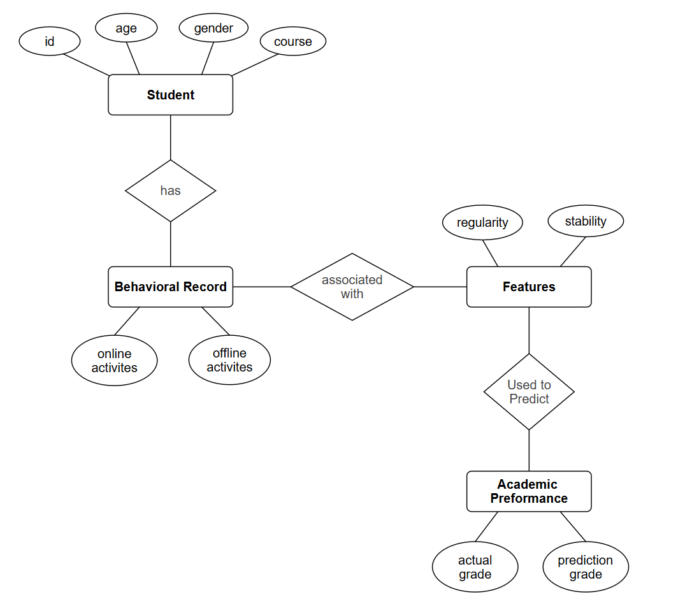
ER DIAGRAM

Slide 17
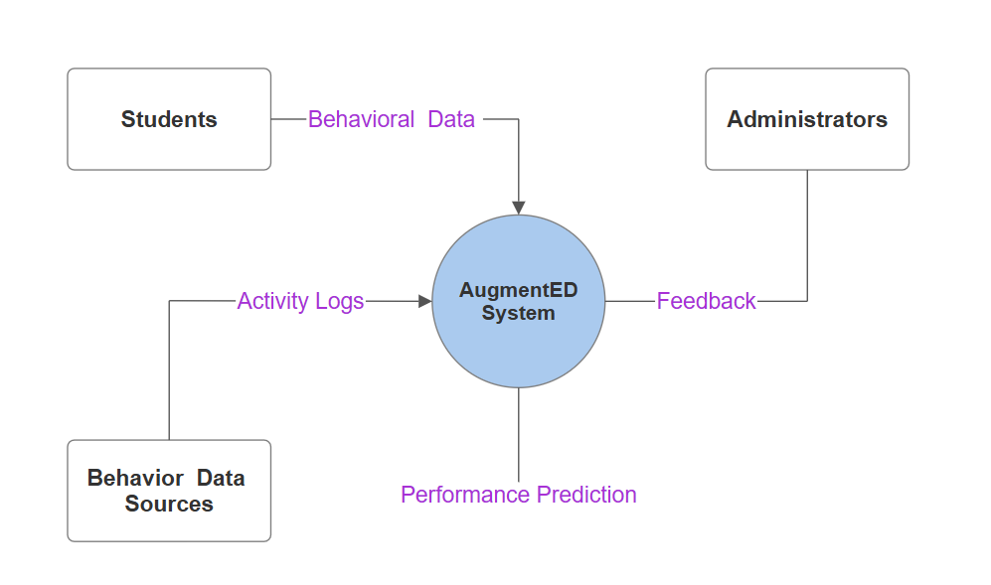
DATA FLOW DIAGRAM
DFD 0 Level

Slide 18
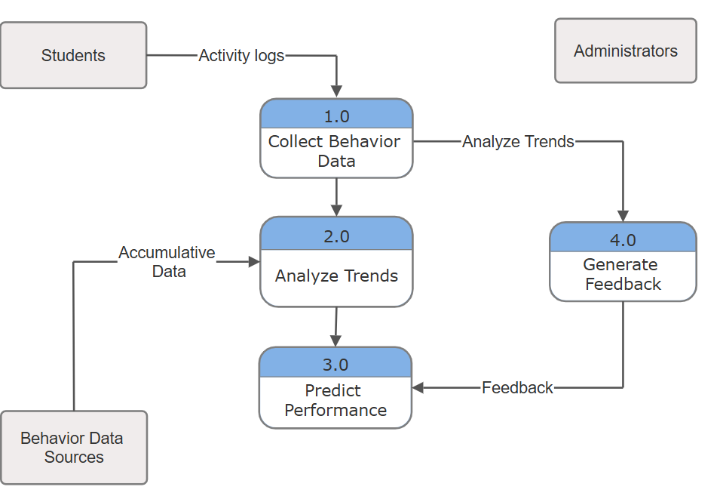
DATA FLOW DIAGRAM
DFD 1 Level

Slide 19
UML DIAGRAMS
LIST OF UML DIAGRAMS:
UML diagrams are used to design and visualize the insider threat detection system.
Class Diagram
Sequence Diagram
Collaboration Diagram
Deployment Diagram
Activity Diagram
Use Case Diagram

Slide 20
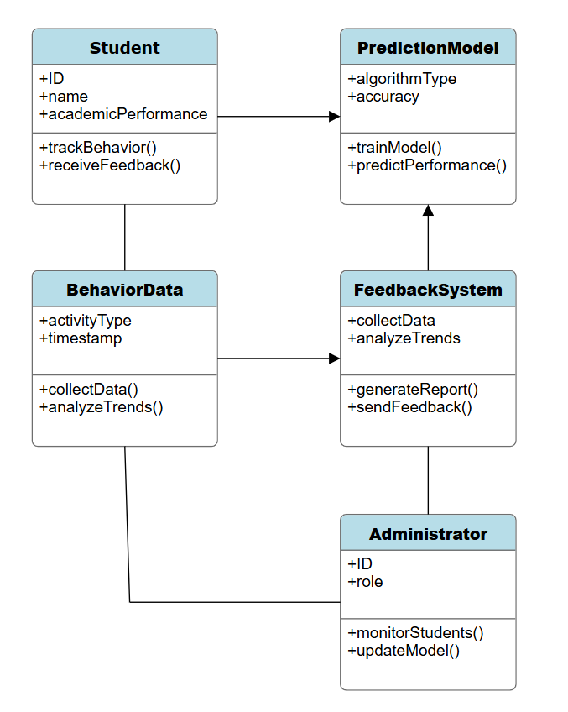
CLASS DIAGRAM

Slide 21
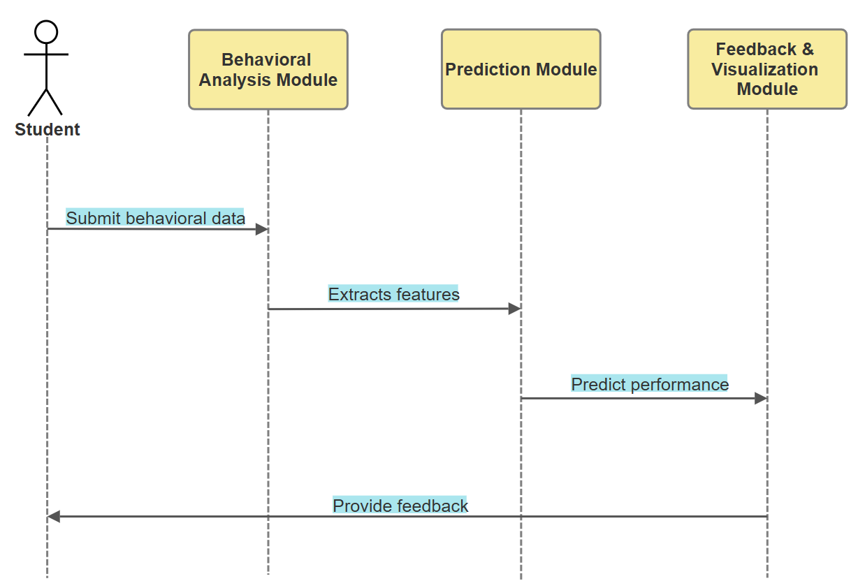
SEQUENCE DIAGRAM

Slide 22
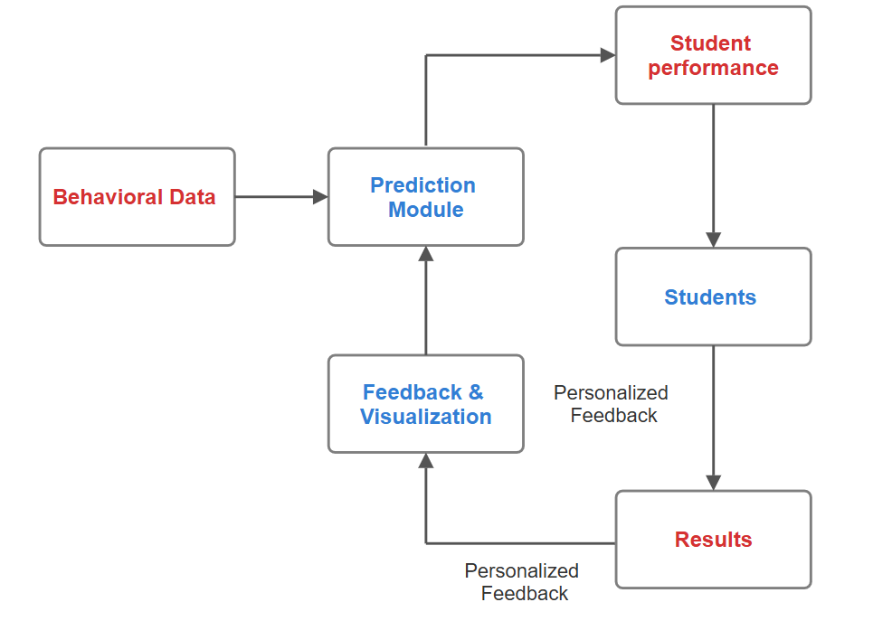
COLLABORATION DIAGRAM

Slide 23
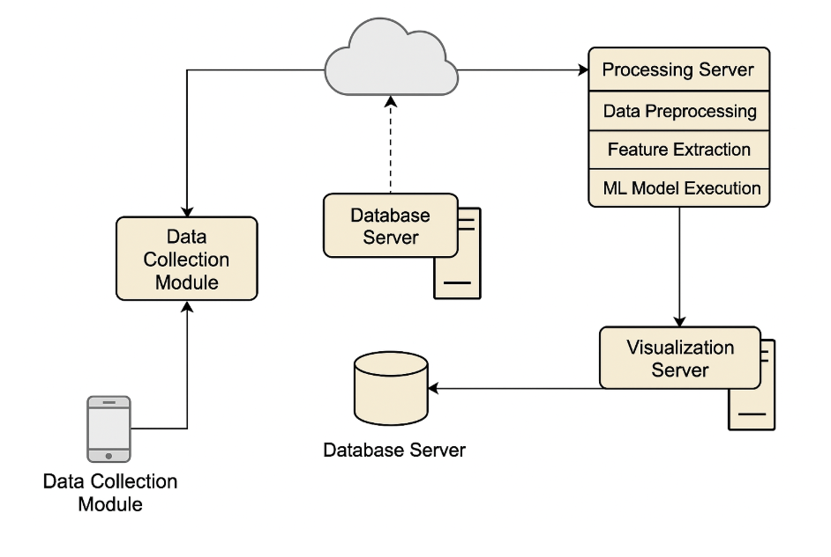
DEPLOYMENT DIAGRAM

Slide 24
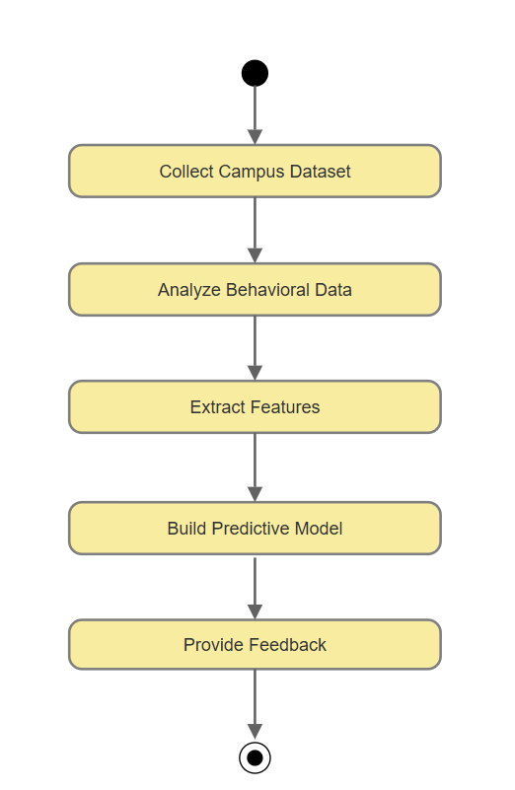
ACTIVITY DIAGRAM

Slide 25
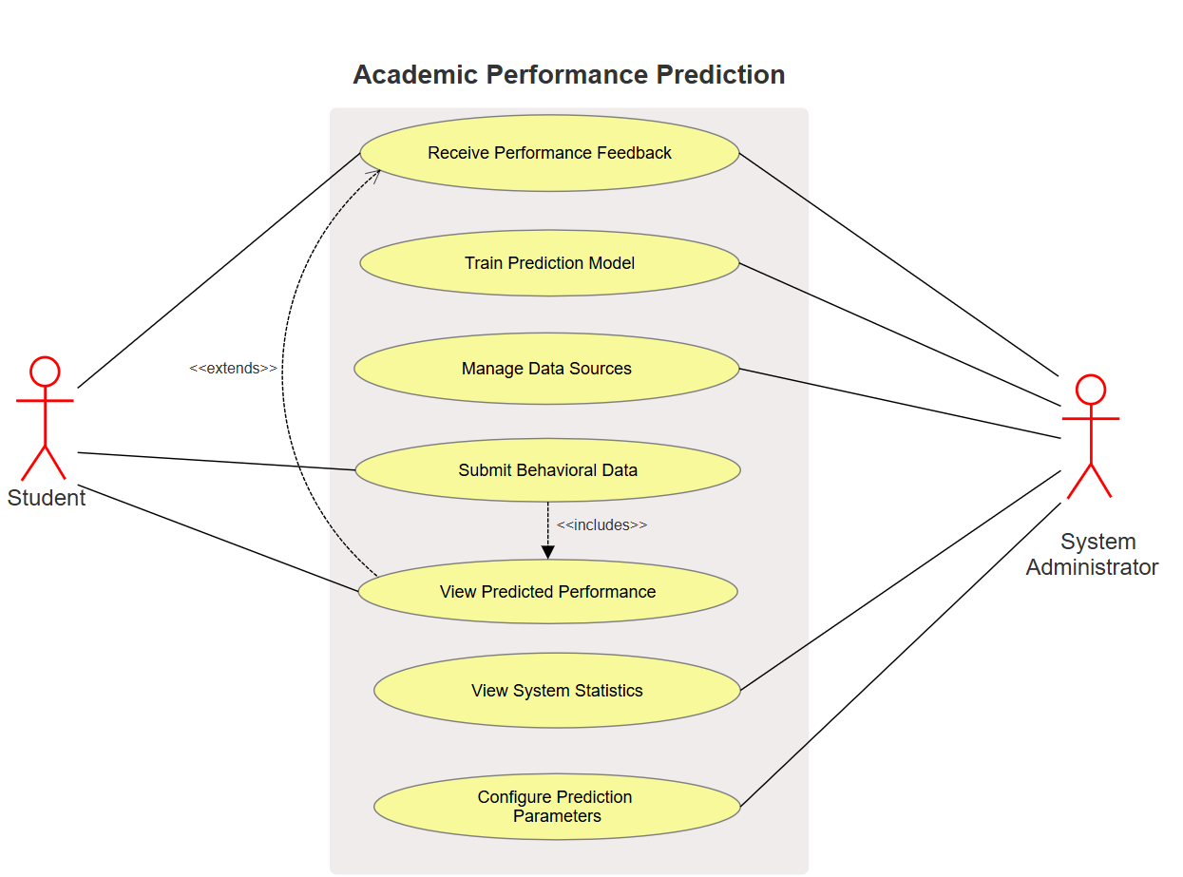
USECASE DIAGRAM

Slide 26
TESTING
Unit Testing:
Unit testing for the AugmentED project focuses on validating each module independently to ensure reliable performance.
Behavioral Analysis Module tests focus on data preprocessing, feature extraction, and LSTM-based behavior detection.
Prediction Module is validated for training accuracy and consistent classification across various datasets.
Feedback Module checks include feedback generation, visual correctness, and UI responsiveness.
Mock datasets and automated scripts ensure robustness, handling edge cases and verifying metrics like precision, recall, and F1-score.

Slide 27
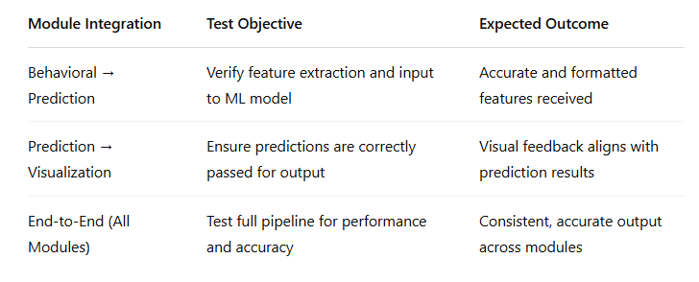
TESTING
Integration Testing :
Integration testing ensures seamless interaction among the three AugmentED modules.
It verifies the proper data flow from behavioral analysis to prediction, and from prediction to feedback.
Each interface is tested to validate data compatibility, functional correctness, and consistency of output across integrated components.

Slide 28
TESTING
System Testing :
System testing for the AugmentED model involved validating each module’s performance, accuracy, and integration.
Real student data was used to ensure the system accurately analyzed behaviors, predicted academic performance, and generated effective feedback.
The model demonstrated reliable functionality, with high prediction accuracy and user-friendly visual feedback.

Slide 29
TESTING
System Testing :
Test Case | Module | Expected Result | Actual Result | Status
Data Ingestion | Behavioral analysis | Accurate data preprocessing | Successfully parsed and normalized data | Passed
Pattern Detection | Behavioral analysis | Identify lifestyle trends via LSTM | Trends accurately captured | Passed
Academic Prediction Accuracy | Prediction Module | ≥85% accuracy | 89% accuracy achieved | Passed
Feedback Generation | Feedback & Visualization | Clear, actionable visual feedback | Relevant and easy to interpret | Passed
System Integration | All Modules | Seamless data flow and module interaction | Smooth operation across modules | Passed

Slide 30
TESTING
Acceptance Testing :
Acceptance testing ensures that the developed AugmentED system underwent acceptance testing to verify its functionality, accuracy and usability.
Key aspects tested included data processing, behavioral feature extraction, prediction accuracy and feedback.
The system was evaluated using a sample dataset (N=156), with benchmarks set for prediction accuracy, response time and user experience.
All modules were tested to ensure they met performance criteria and usability expectations for effective student support and intervention.

Slide 31
TESTING
Acceptance Testing :
Test Case | Expected Result | Actual Result | Status
Data Ingestion | Successful processing of dataset | Dataset processed without errors | Passed
Feature Extraction (LSTM) | Accurate pattern identification | Patterns extracted as expected | Passed
Prediction Accuracy | ≥85% accuracy | Achieved 87.3% accuracy | Passed
Visualization Feedback | Clear, student-friendly insights | Interactive and understandable UI | Passed
At-risk Student Detection | Correctly flag low performers | At-risk students accurately flagged | Passed

Slide 32
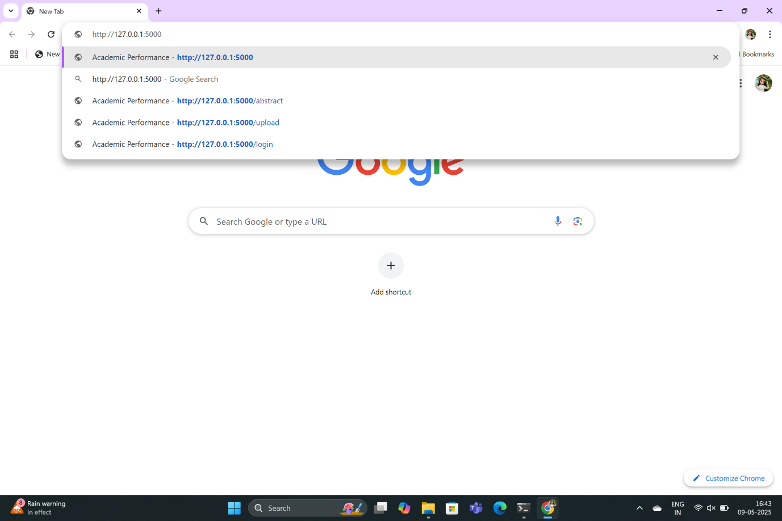
SCREENSHOTS
URL

Slide 33

SCREENSHOTS
Home Page

Slide 34
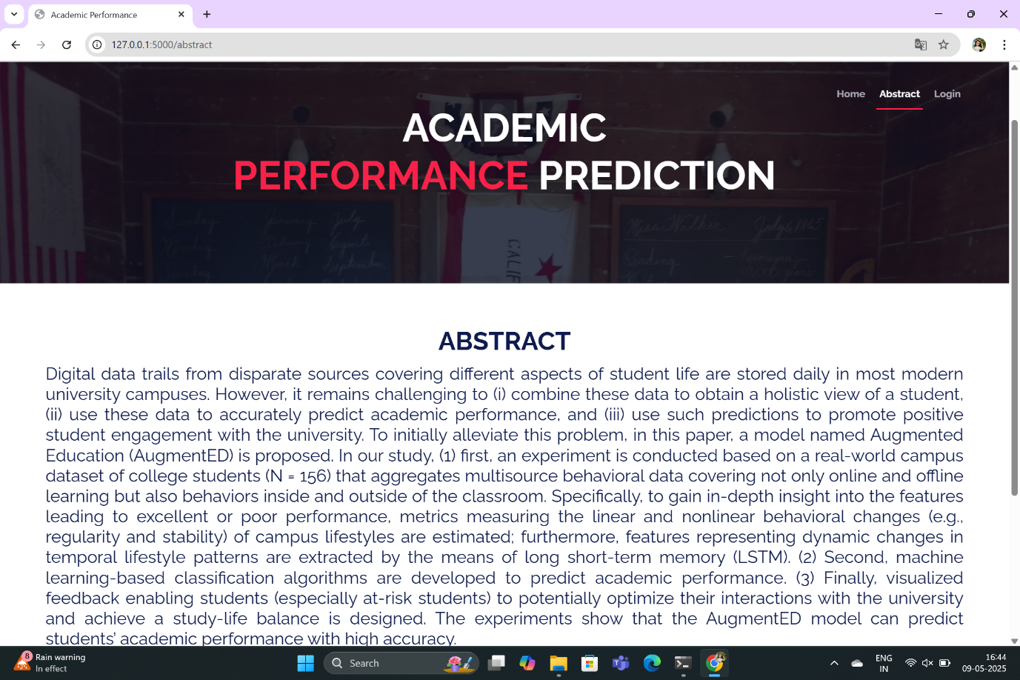
SCREENSHOTS
Abstract Page

Slide 35
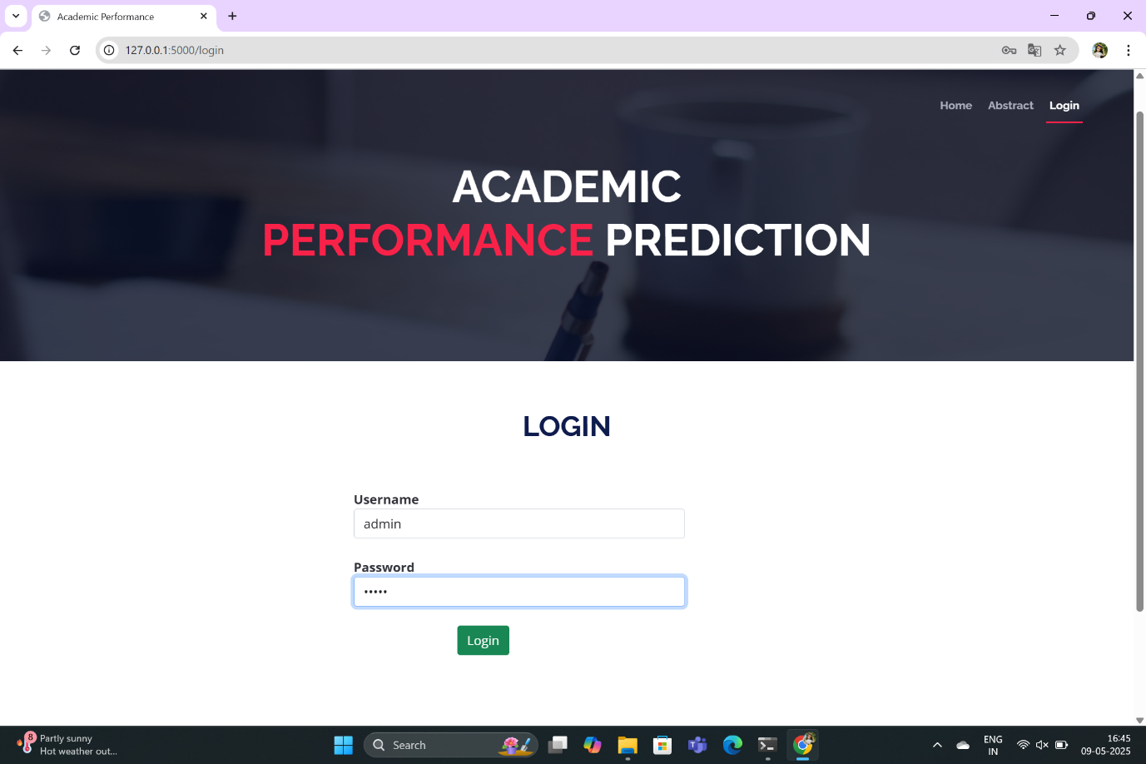
SCREENSHOTS
Login Page

Slide 36
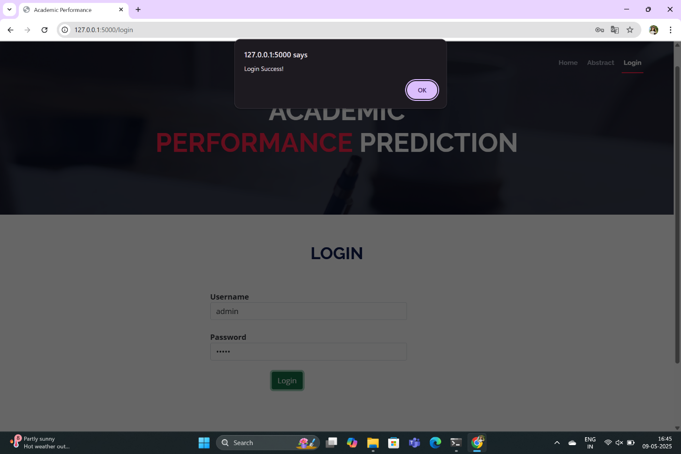
SCREENSHOTS
Login Success

Slide 37
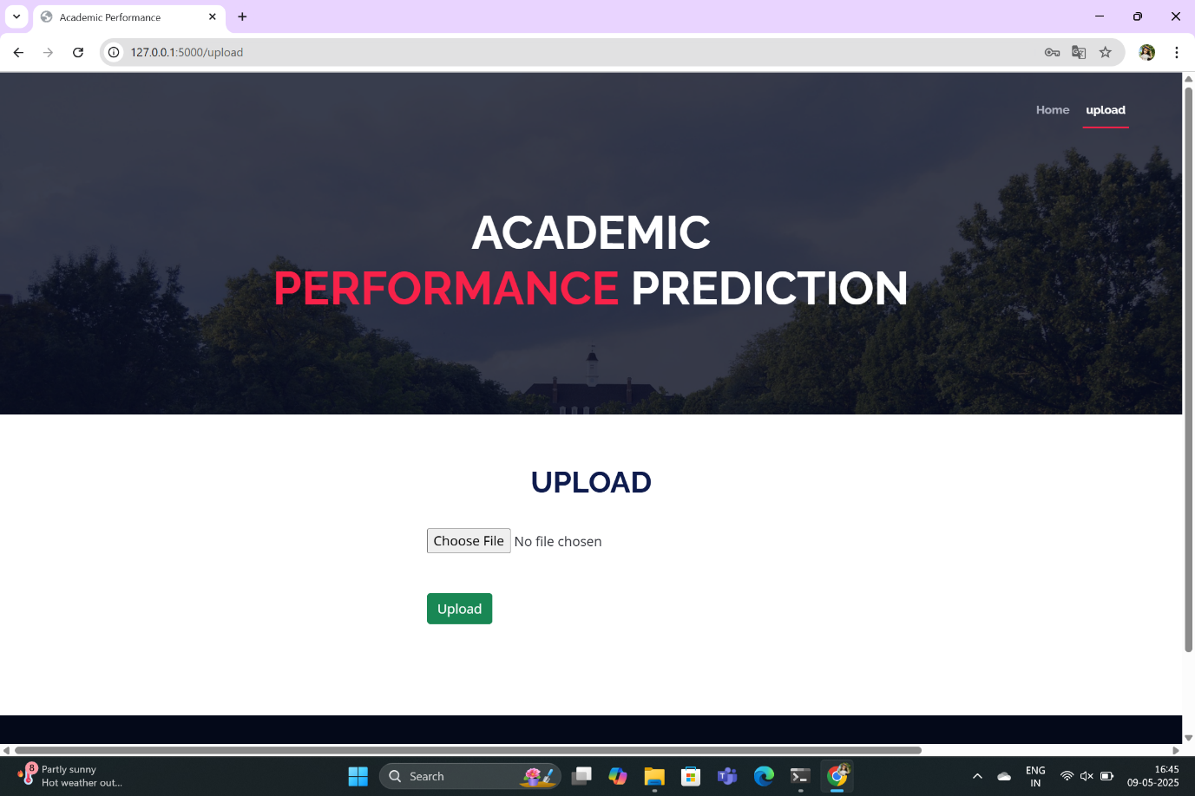
SCREENSHOTS
Dataset Upload

Slide 38
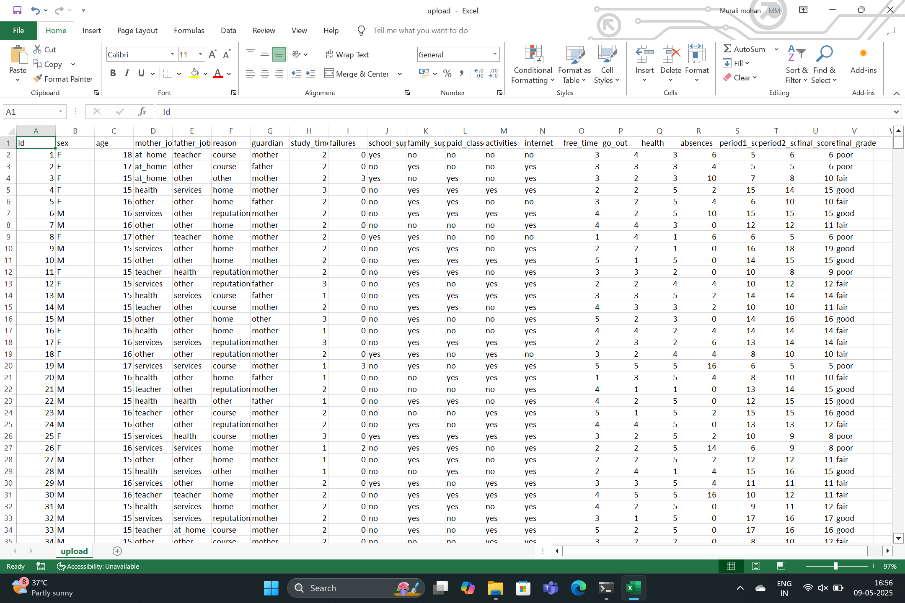
SCREENSHOTS
CSV file

Slide 39
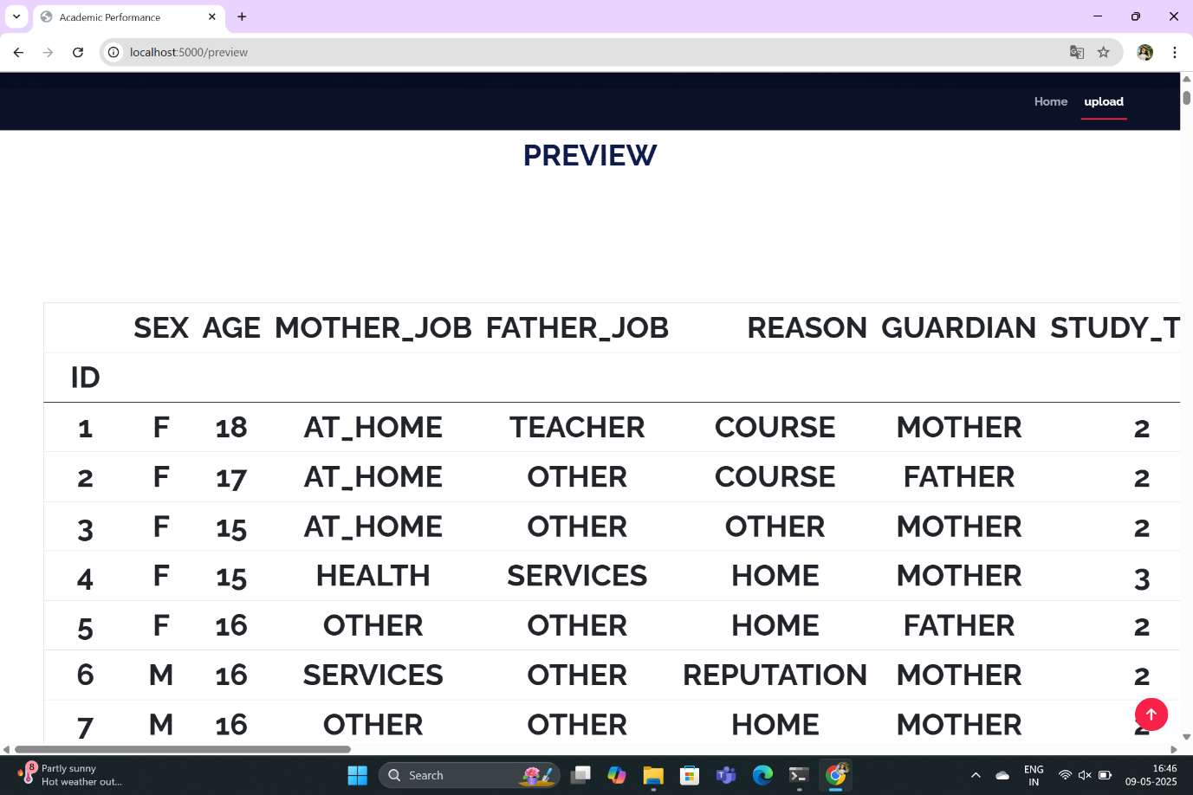
SCREENSHOTS
View Dataset Page

Slide 40
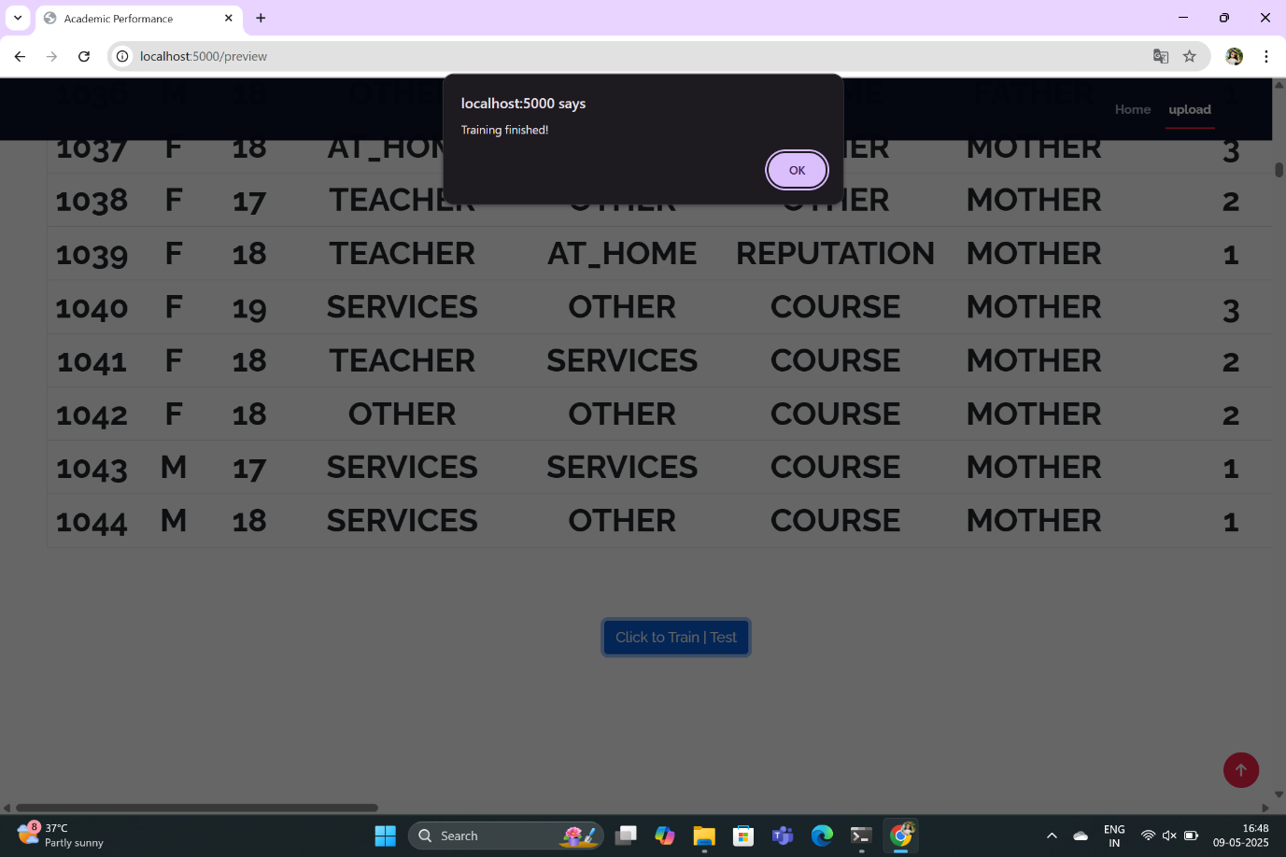
SCREENSHOTS
Train Data

Slide 41
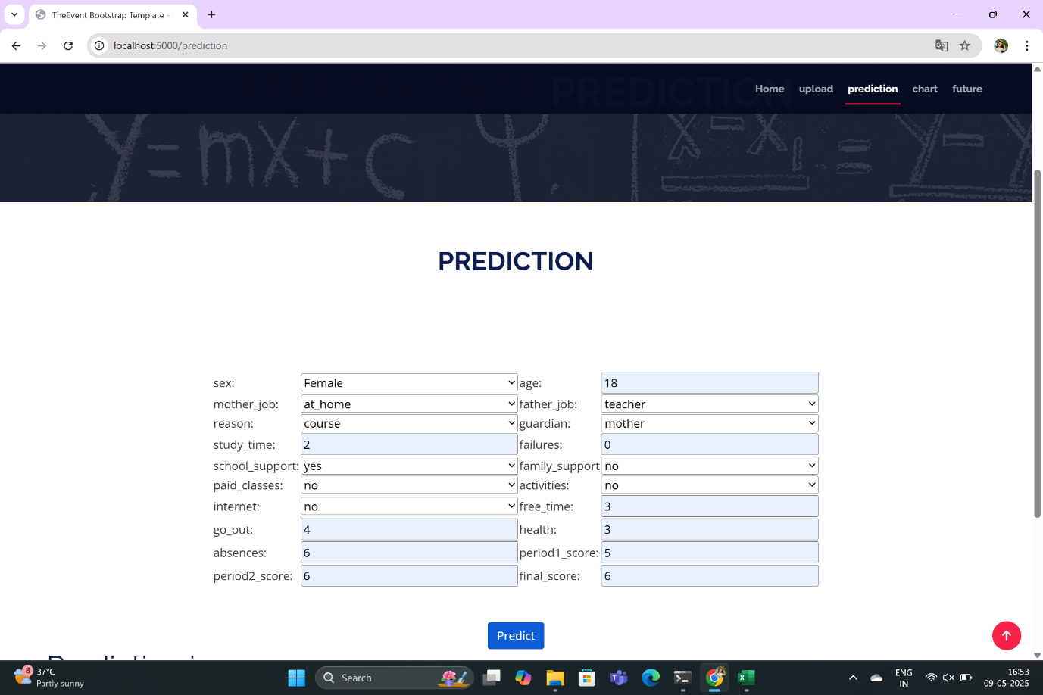
SCREENSHOTS
Enter Details

Slide 42
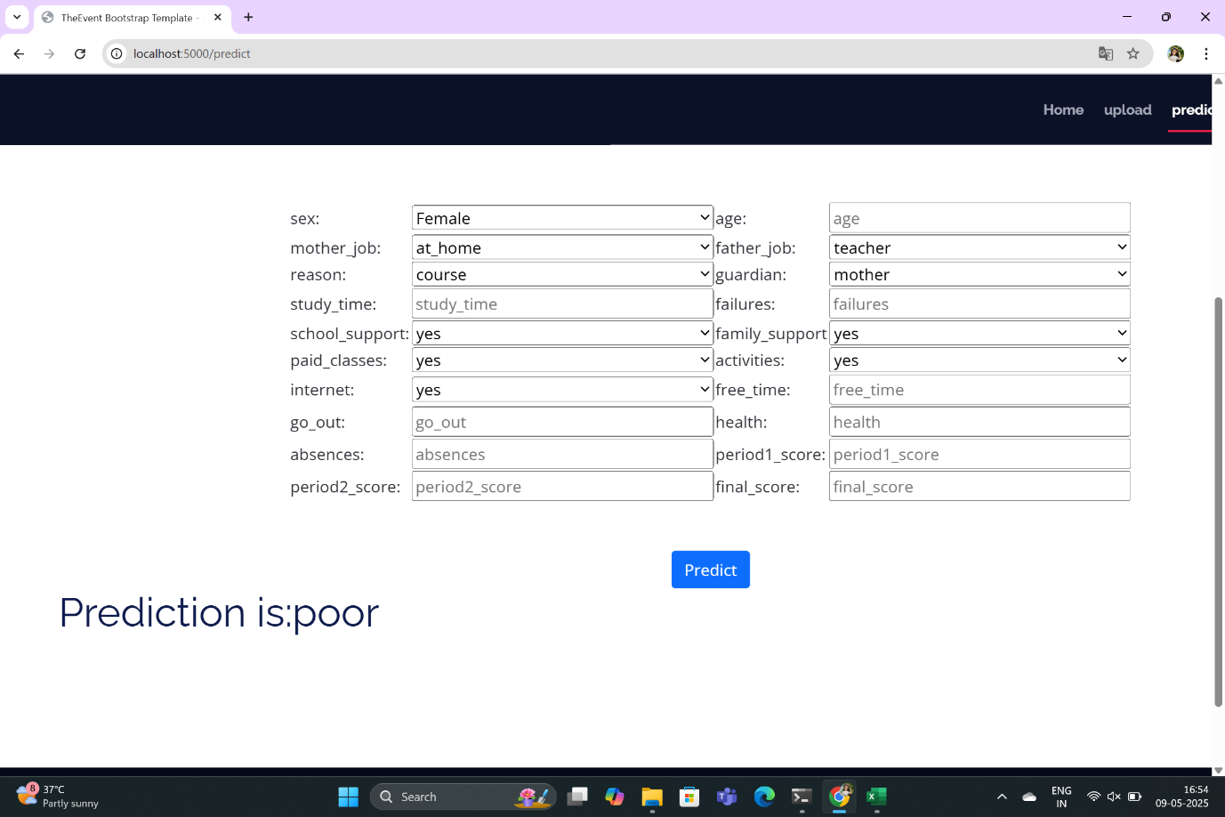
SCREENSHOTS
Prediction

Slide 43
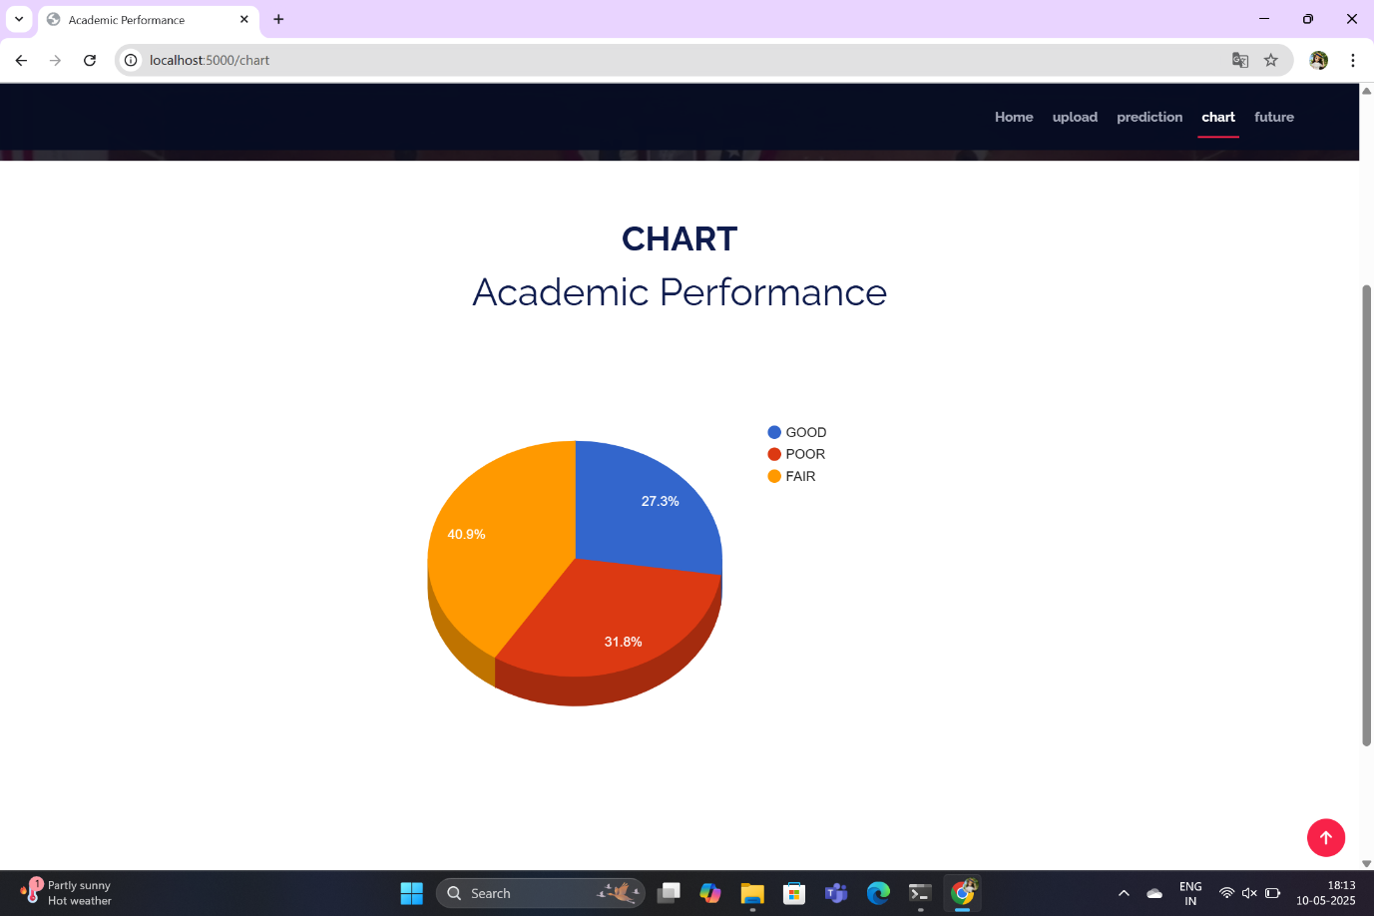
SCREENSHOTS
chart

Slide 44
CONCLUSION
The AugmentED model combines behavioral analysis, machine learning, and feedback to improve student performance.
It uses real-world data from both online and offline student activities on campus.
LSTM helps detect important behavioral patterns like regularity, stability, and lifestyle trends.
These patterns are linked to academic outcomes, helping identify what influences success or underperformance.
The prediction module accurately forecasts student performance using these features.
At-risk students are identified early for timely support and intervention.
Feedback and visualizations guide students to improve habits, time use, and academic planning.

Slide 45
REFERENCES
A. Furnham, and J. Monsen, “Personality traits and intelligence predict academic school grades," Learning and Individual Differences, vol. 19, no. 1, pp. 0-33, 2009.
M. A. Conard, “Aptitude is not enough: How personality and behavior predict academic performance,” Journal of Research in Personality, vol. 40, no. 3, pp. 339-346, 2006.
T. Chamorropremuzic, and A. Furnham, “Personality predicts academic performance: Evidence from two longitudinal university samples,” Journal of Research in Personality, vol. 37, no. 4, pp. 319- 338, 2003.
R. Langford, C. P. Bonell, H. E. Jones, T. Pouliou, S. M. Murphy, and E. Waters, “The WHO health promoting school framework for improving the health and well‐being of students and their academic achievement,” Cochrane Database of Systematic Reviews, vol. 4, no. 4, pp. CD008958, 2014.
A. Jones, and K. Issroff, “Learning technologies: Affective and social issues in computer-supported collaborative learning,” Computers & Education, vol. 44, no. 4, pp. 395-408, 2005.

Slide 46
MCA IV Semester Project Final Review Presentation
Thank you….!!

